Slide 1
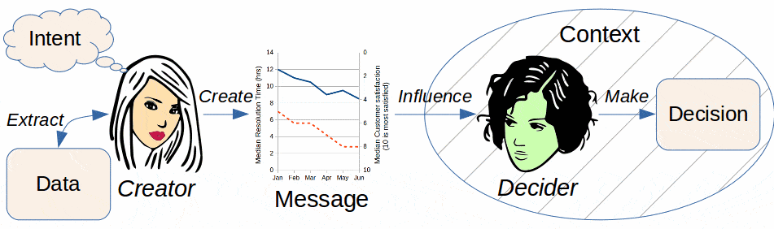

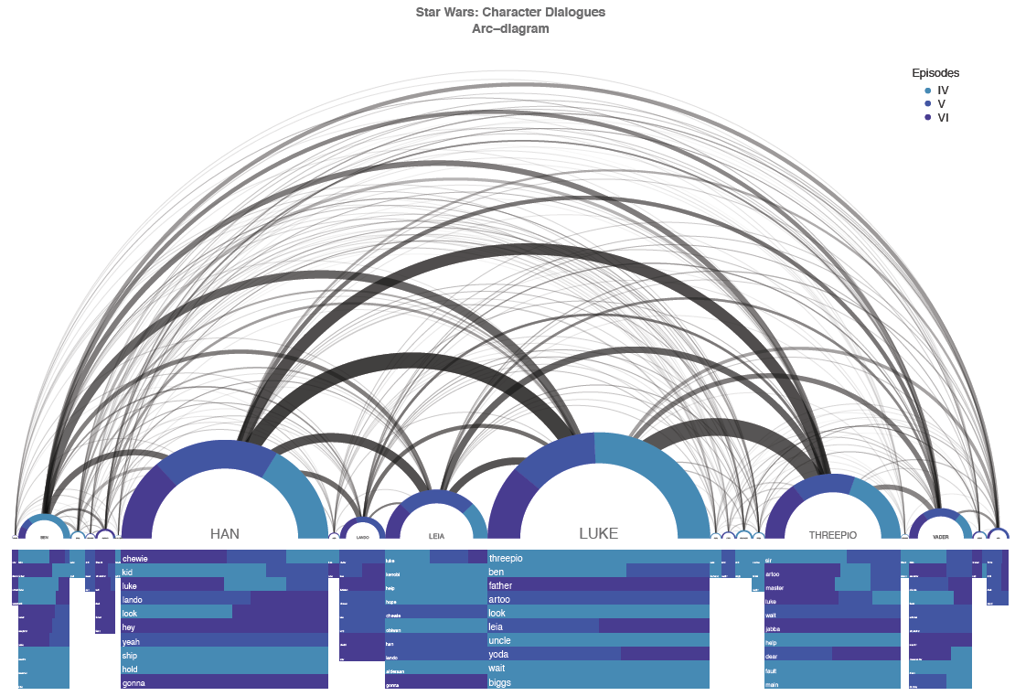
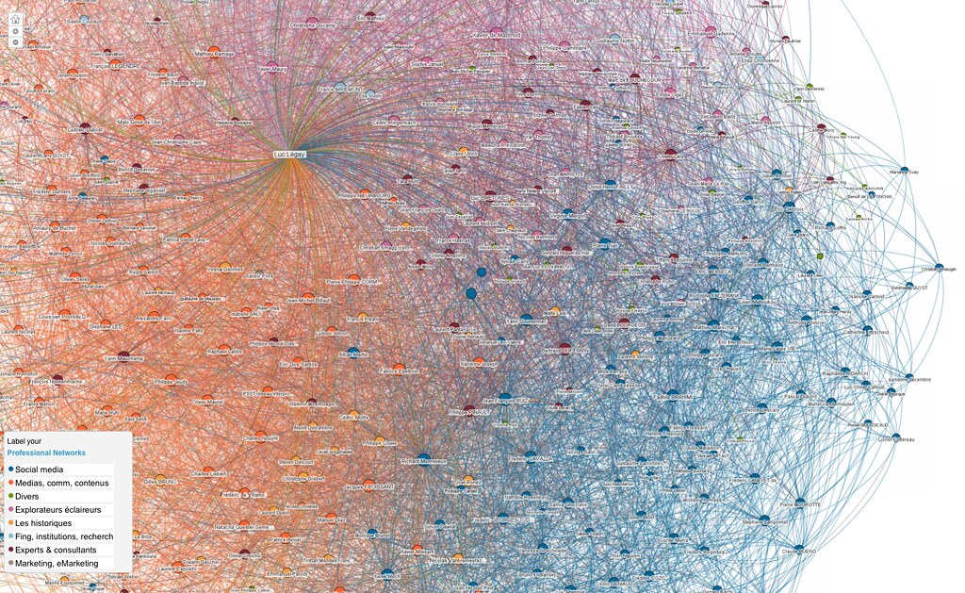
Misleading Visuals- They are not what they appear to be by Moshe Burnstein
This Photo by Unknown author is licensed under CC BY-NC.
This Photo by Unknown author is licensed under CC BY-SA-NC.
This Photo by Unknown author is licensed under CC BY-ND.

Slide 2
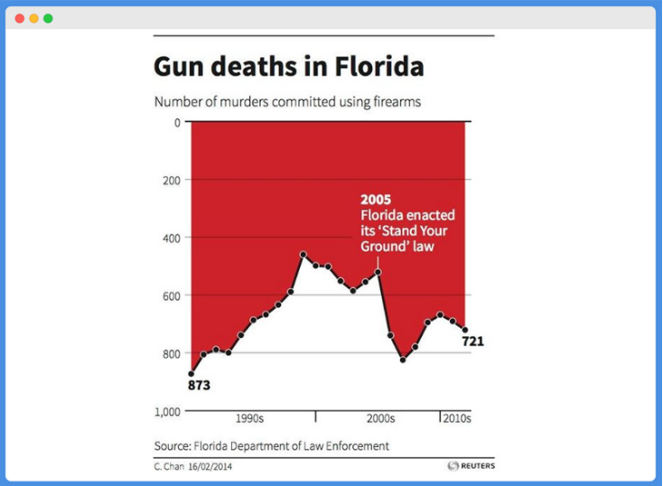
Upside Down Graph
This visual implies that something diminished following the enactment of the law. In reality, there was a great spike in gun deaths. The y-axis begins at 1000 instead of at 0.

Slide 3
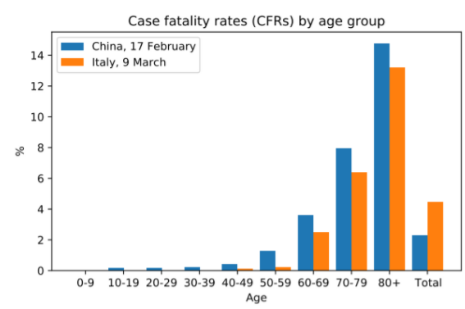
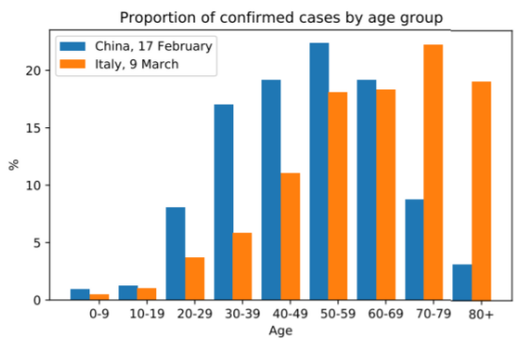
Simpson's Paradox
The graph below presents the CFR, or the number of people dying divided by the number of people infected. It clearly is an indictment of Chinese care. However, the aggregate view sometimes does not concur with the categorized view.
The graph below paints a picture of the demographics of the infected in each country. Luckily for China, its infections were concentrated in a younger population, who are much less likely to die from infection. But it was not luck. Italy has a much older population.

Slide 4
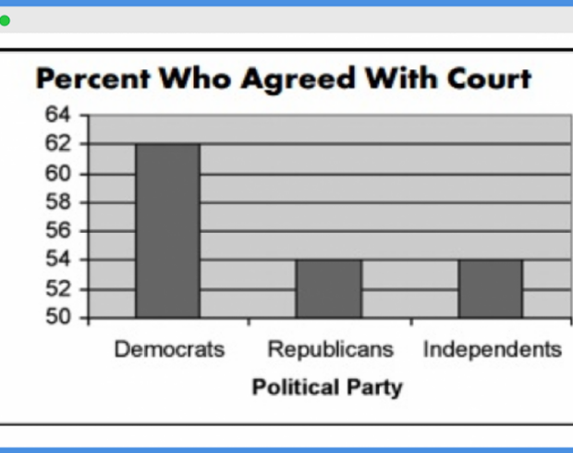
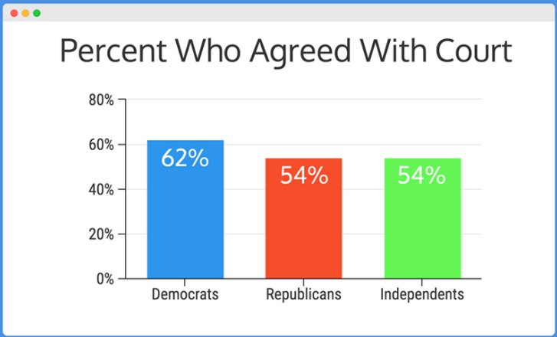
Truncating the Graph
The left graph implies a great difference between Democrats on one side, and Republicans and Independents on the other. The right graph shows how in reality there is general consensus. The y-axis begins at 0%, and the actual % numbers are expressed.

Slide 5
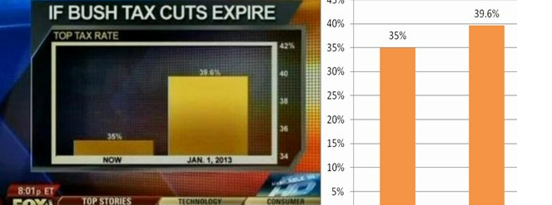
The right graph portrays a more reasonable picture of the effect of the tax cut expiration. The left graph begins at 34% and thereby overemphasizes the difference between a 35% tax rate and a 39.6% one.

Slide 6
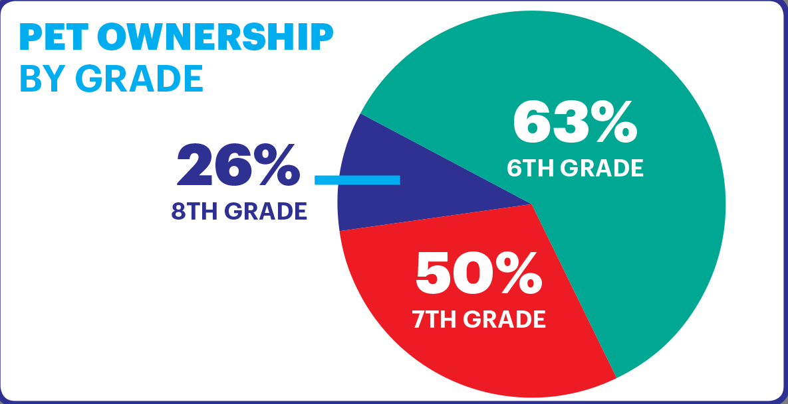
26+50+63=139
Pie charts must add up to 100%. While not necessarily portraying pet ownership by grade deceptively, this graph is just wrong. A bar graph would be appropriate.

Slide 7
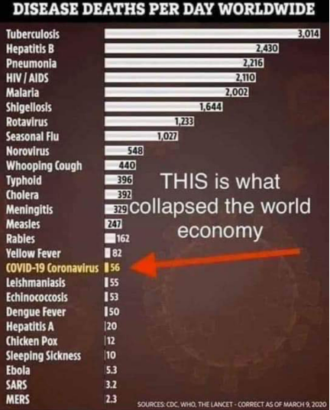
Were We Mistaken?
Did we overreact? Retrospect seems to give a resounding no. Covid-19 crippled us. SARS is very infectious and requires drastic measures to stem rising infection rates. Practically, Covid-19 poses a much greater danger to our society than rabies does.

Slide 8
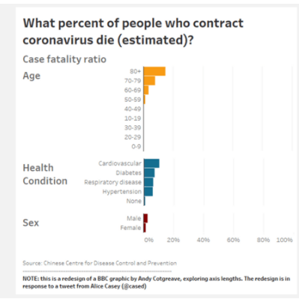
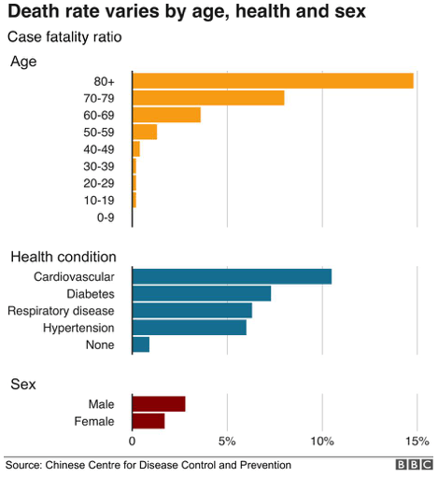
Overstating
The graph below seems to pull one's eyes all the way to the right for the 80+ group. One would be frantic for the 80+.
The graph below paints a fairer picture. The actual % difference is shown to be not so great and it catches the eye. The visual on the right gives context and shows the situation to be anything but hopeless.

Slide 9
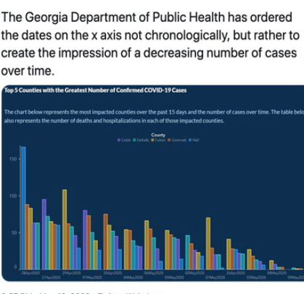
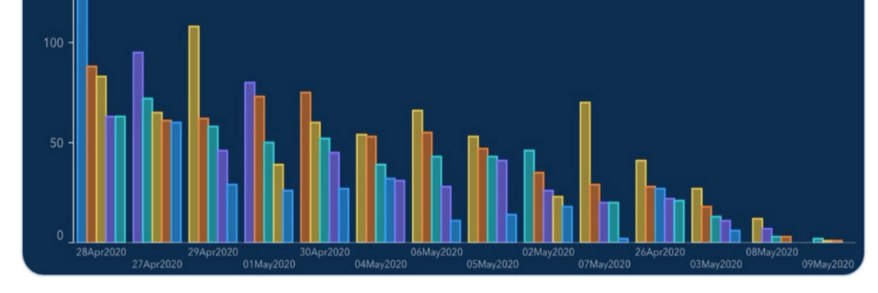
Egregious
It appears that the Georgia Department of Health is providing evidence of a consistent decline in Covid-19 rates over five counties. When one takes a closer look, however, the months are not in order. Whether through bad intent or just plain negligence, as the administration contended, this graph does not present a true picture.

Slide 10
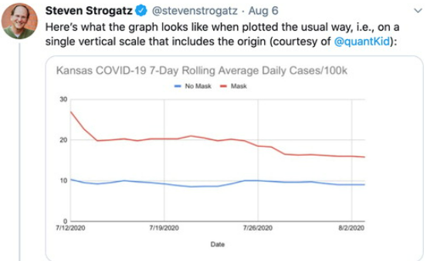
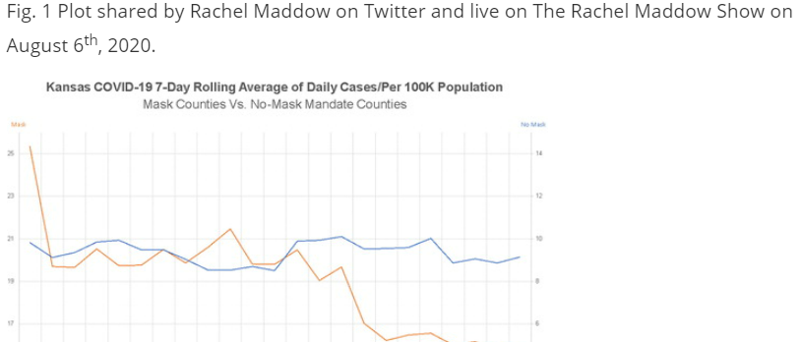
Mask Mandates: Panacea?
The chart on the right produced by the Kansas Department of Health, portrays a great decline in infections as a result of mask mandates. The confusion starts with the presentation of two vertical axes. Tufte explains in his book The Visual Display of Quantitative Information that while two vertical axes might display an association in a time series, it does not show comparison. Moreover, the vertical axes representing the daily number of cases are on different scales. The visual on the left accurately portrays a gentle decline in places of mask mandate while also showing that the case numbers in mask mandate locales never went below the number of cases in non-masked locales. Counties with higher infection rates still had higher rates, irrespective of mask mandates. While employing two vertical axes is forgivable, using different scales is inexcusable.

